Slide 1
RAFAL JASINSKI
UX Project
Head of Department:
David Randell
Assessing Lecturers:
David Randell

Slide 2

My Vodafone Project

Slide 3
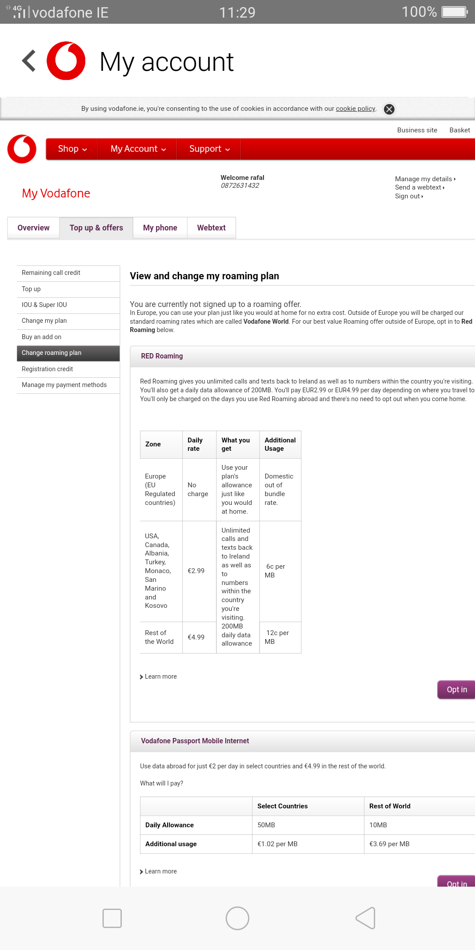
My Vodafone fault:
the app sends us to the website.
the website is not responsive.
we need a zoomed page.
the buttons are hard to see.

Slide 4
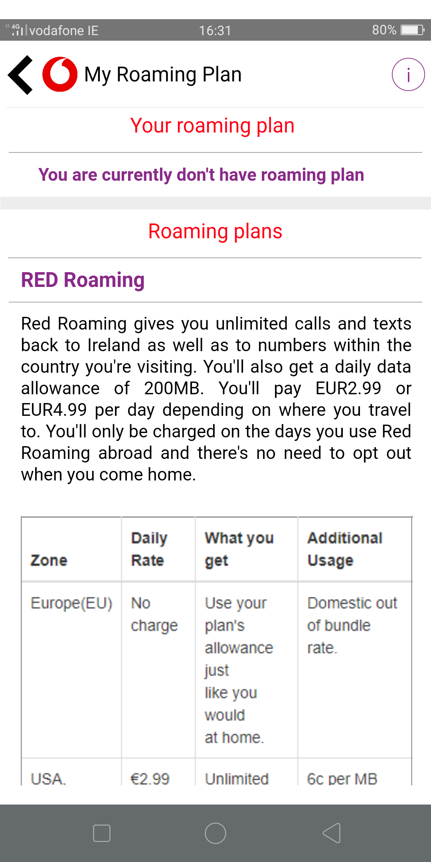
My Vodafone Prototype:
most important information about roaming.
mobile friendly.
the app don’t send us to the website.
the buttons are more visible.

Slide 5
Prototype https://pr.to/A6TP78/

Slide 6
Thank You

